Slide 1



Patterns in Fatal Police Shootings: A Data-Driven Approach
Yousra Shleibik
Elijah Alabi
Saka Suleiman
Notes:
Good evening. Today we're presenting our data-driven analysis of fatal police shootings in the United States from 2015 till date. I’m Yousrah and I'll be presenting alongside my colleagues Elijah, and Saka

Slide 2


Motivation & Significance
01
02
03
04
Fatal police shootings are a critical public safety and social justice issue
Growing public concern about racial and demographic disparities in police shootings
Insight into how policing practices and demographics intersect with public safety
Understanding patterns can inform policy reforms
Notes:
Fatal police shootings are a critical public safety and social justice issue. Growing concern focuses on racial disparities and the need for accountability. By analyzing patterns, we aim to inform reforms, improve transparency, and address systemic inequalities in law enforcement..
Next, we’ll explore the Data Sources behind this analysis

Slide 3


Data Source & Definitions
Source: Washington Post Police Shootings Database
Demographic information | Age, Gender, Race
Geographic data | State, City, County, Coordinates
Situational factors | Armed status, Threat type, Flee status
Contextual elements | Body camera usage, Mental illness indicators
Notes:
We utilized The Washington Post's Police Shootings Database, which tracks fatal shootings nationwide since 2015. Our analysis includes demographic information, geographic data, situational factors like armed status, and contextual elements such as body camera usage and mental illness indicators.

Slide 4


Research Question
How can police departments be categorized based on patterns in fatal shooting incidents?
Notes:
Our primary research question asks: How can police departments be categorized based on patterns in fatal shooting incidents?

Slide 5

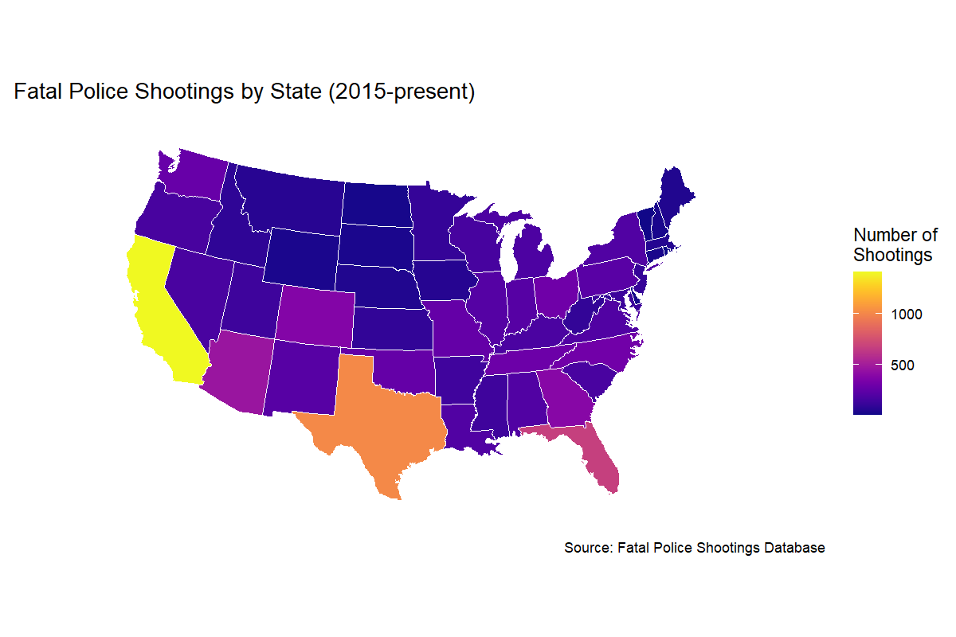
Exploratory Data Analysis (EDA)
Heatmap by State
Notes:
In our Exploratory Data Analysis (EDA), we start with a heatmap showing raw shooting counts by state. High-population states like California and Texas dominate, but raw numbers don’t tell the full story.
Next, we’ll normalize the data to reveal a more accurate picture

Slide 6
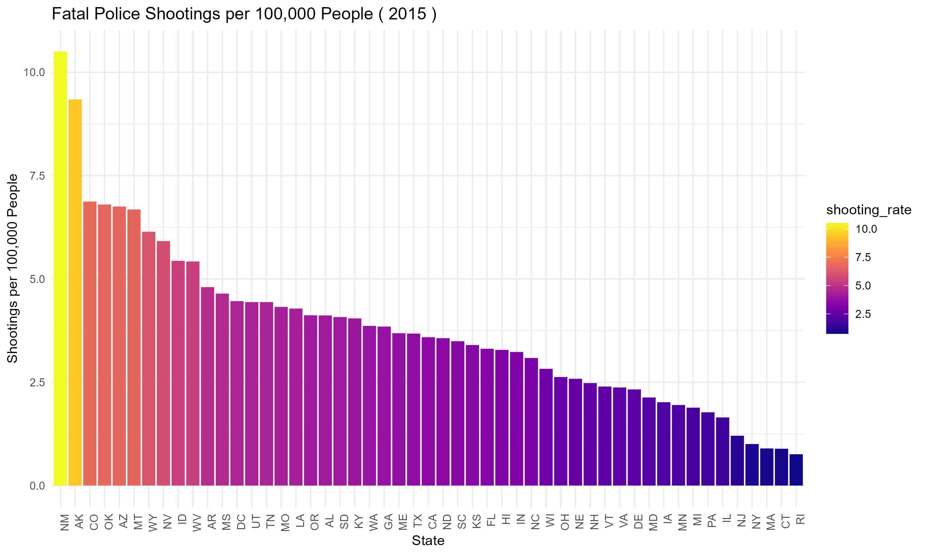
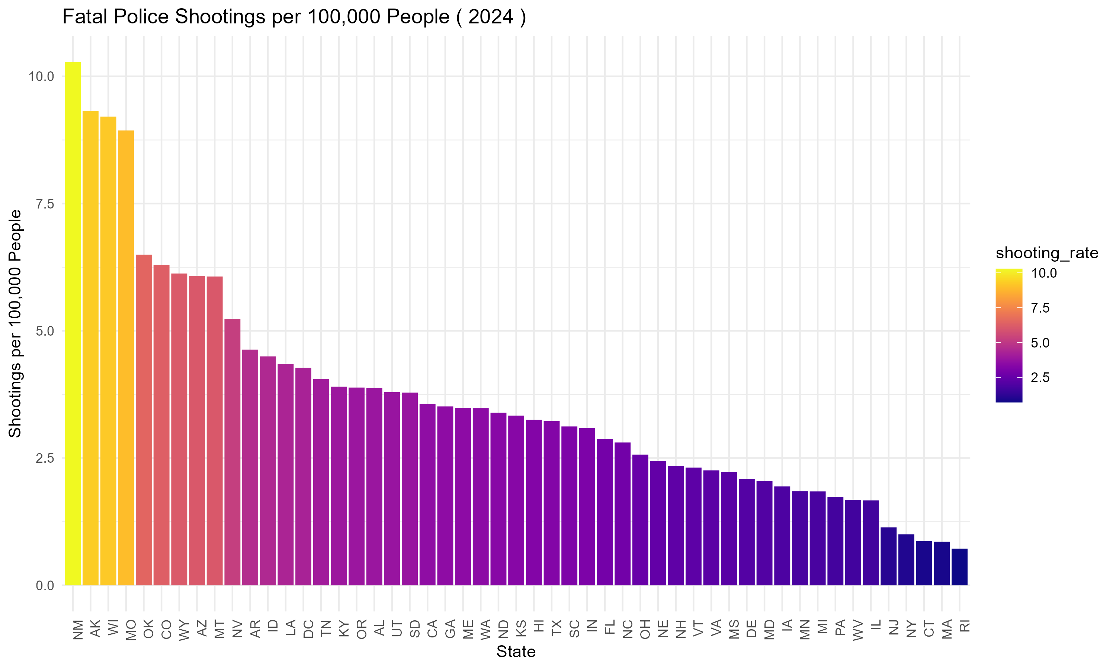
Exploratory Data Analysis (EDA)
Heatmap by State for 2015 & 2024(Normalized)
Notes:
Now, when we normalize for population, the results shift. California has the most shootings overall, but New Mexico has a higher rate per capita, while Rhode Island stays low despite its small size. From 2015 to 2024, New Mexico consistently leads, followed by Alaska.
Why normalize? It accounts for population size, ensuring fair comparisons. Without it, larger states like California would always seem worse just because they’re bigger. Normalization helps us identify areas with unusually high rates, so we can focus on where interventions are most needed.

Slide 7
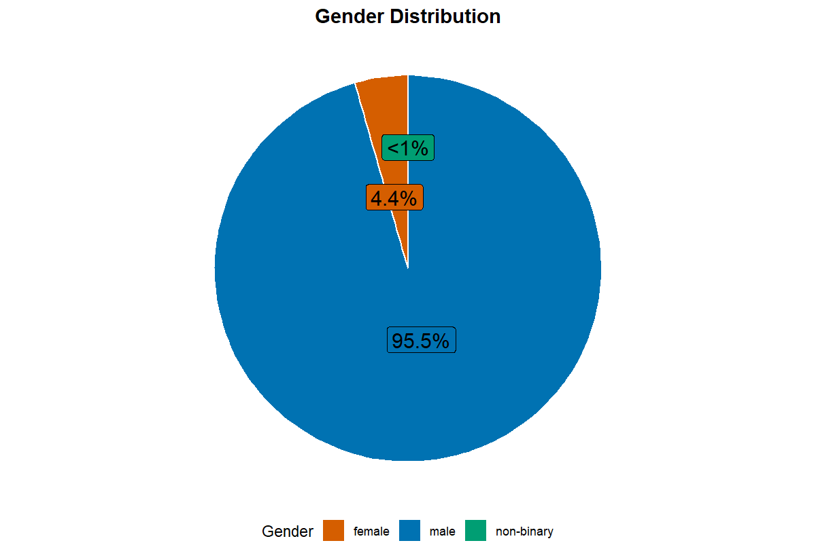
EDA - Key Demographic Patterns
Gender Distribution
Notes:
Now we move into the key demographic patterns. This pie chart shows that the overwhelming majority of victims are male around 95%.

Slide 8
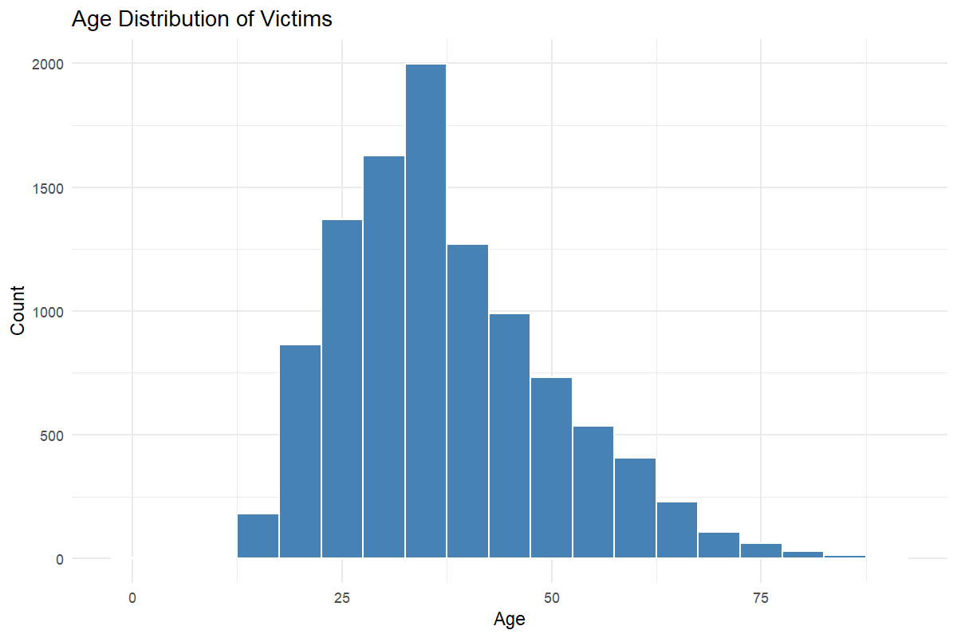
EDA - Key Demographic Patterns
Age Distribution
Notes:
The age distribution shows that most victims are between 20 and 40 years old, with a median age of 36. This highlights that young to middle-aged adults are the most affected group.

Slide 9
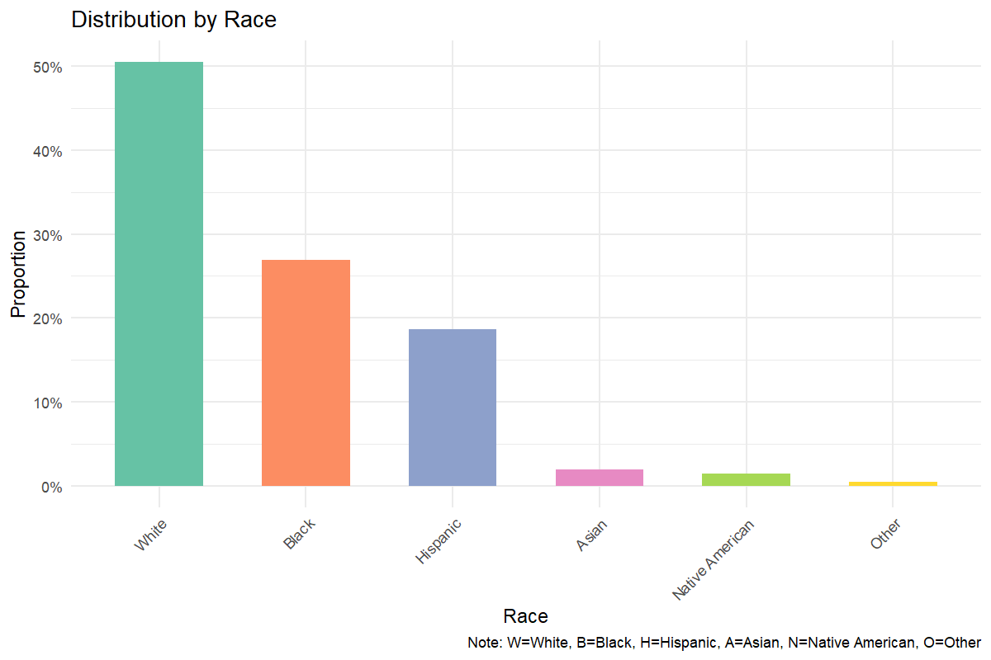
EDA - Key Demographic Patterns
Race Distribution
Notes:
Looking at race, we see that White individuals comprise about 50% of victims, Black individuals about 27%, and Hispanic individuals about 19%. However, these raw percentages don't account for population proportions

Slide 10
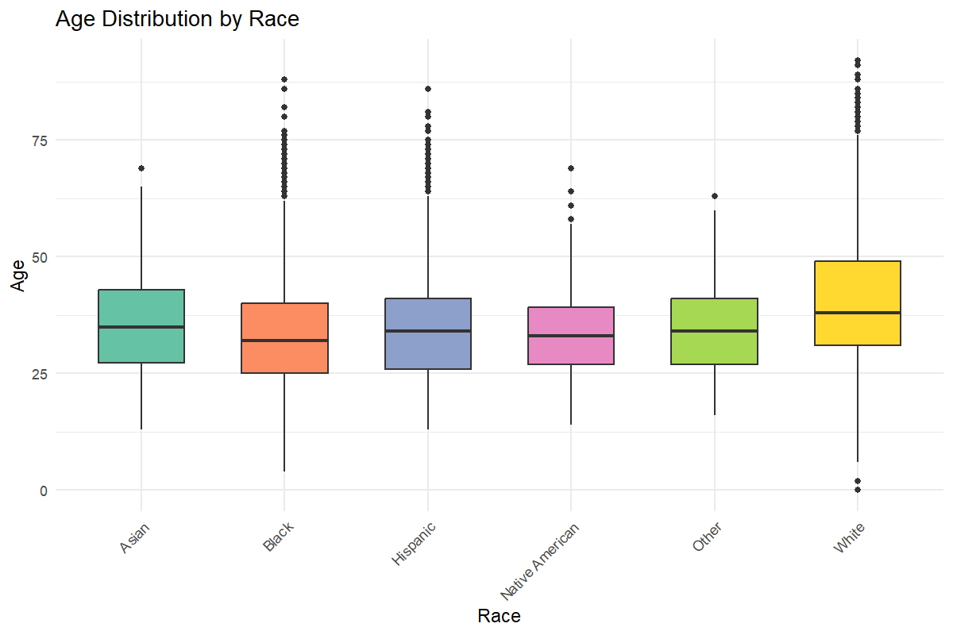
EDA - Key Demographic Patterns
Race Distribution by Race
Notes:
This boxplot compares age distributions across racial groups. While the median ages are similar, we see subtle differences in age distribution patterns across races, with some groups showing more outliers at younger or older ages

Slide 11
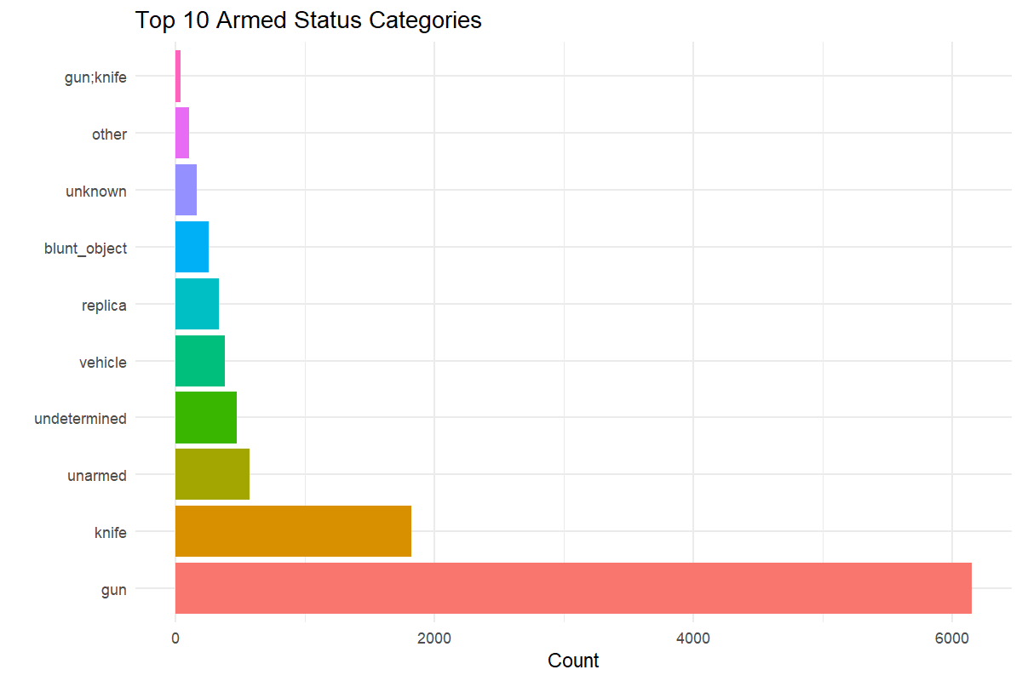
EDA - Situational Characteristics
Armed Status
Notes:
Now diving into the Situational Characteristics. Over 90% of victims were armed. Firearms dominate, but ‘unarmed’ and ‘undetermined’ categories persist. This challenges the common perception that many victims are unarmed."

Slide 12
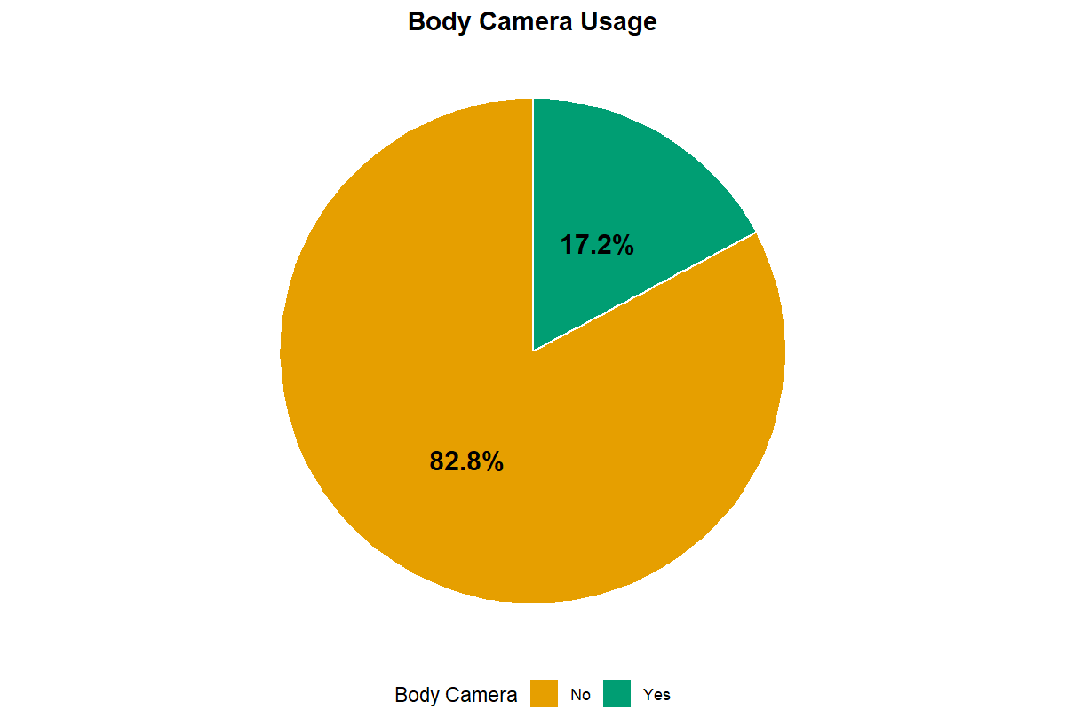
EDA - Situational Characteristics
Body Camera Usage
Notes:
Only 17.2% of incidents involved body cameras. This represents a significant transparency gap, but our survival analysis report later shows cameras correlate with longer intervals between shootings, a potential deterrent effect.

Slide 13
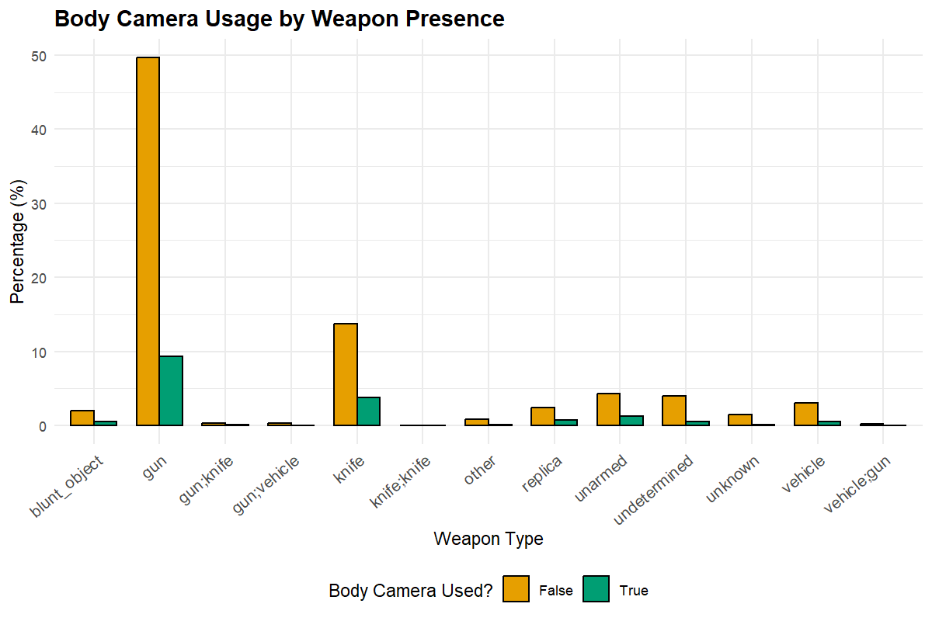
EDA - Situational Characteristics
Body Camera Usage by Weapon Presence
Notes:
Interestingly, body camera usage varies by weapon type. The substantial difference in camera usage across weapon categories suggests potential biases in when officers activate recording devices.

Slide 14
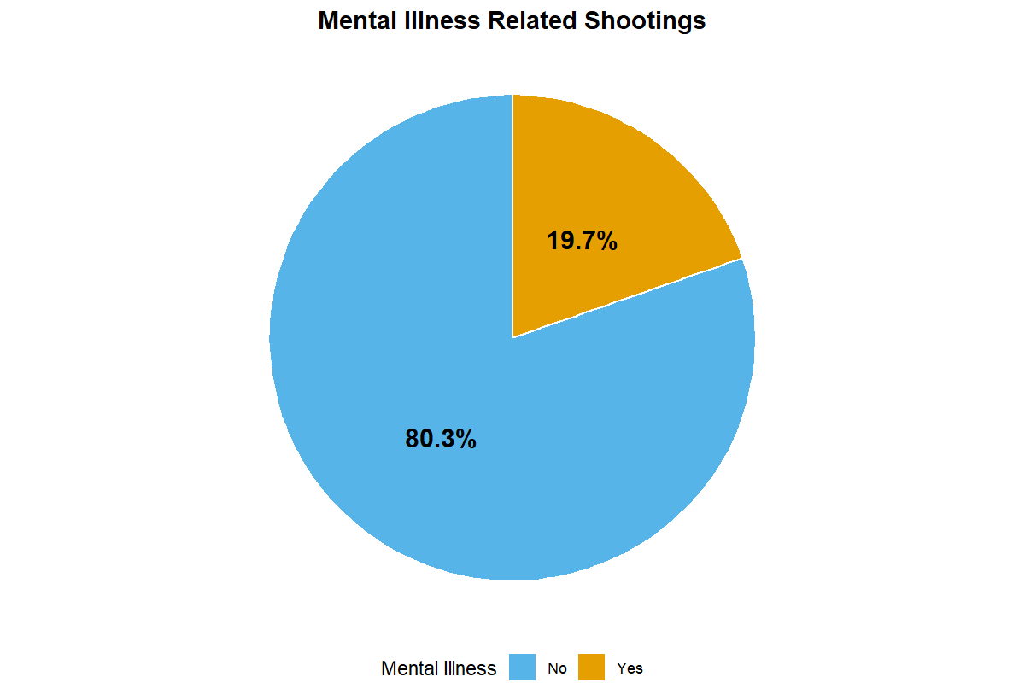
EDA - Situational Characteristics
Mental Illness Status
Notes:
About 1 in 5 shootings involve mental health crises. This demands better crisis intervention training and partnerships with mental health professionals to reduce lethal outcomes.

Slide 15
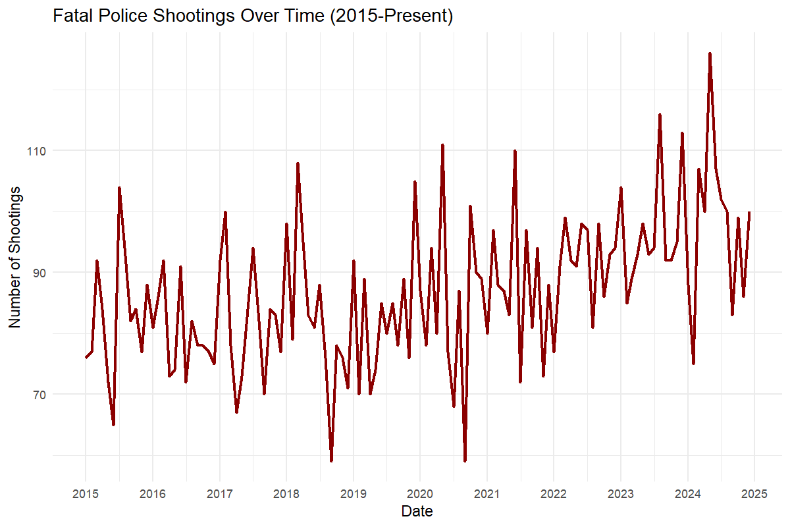
Temporal Trends
Fatal Police Shootings Over Time
Notes:
Examining trends over time, we observe moderate fluctuation in the monthly frequency of shootings, with an upward trend in recent years. There are also seasonal patterns worth noting, with slight increases during summer months

Slide 16
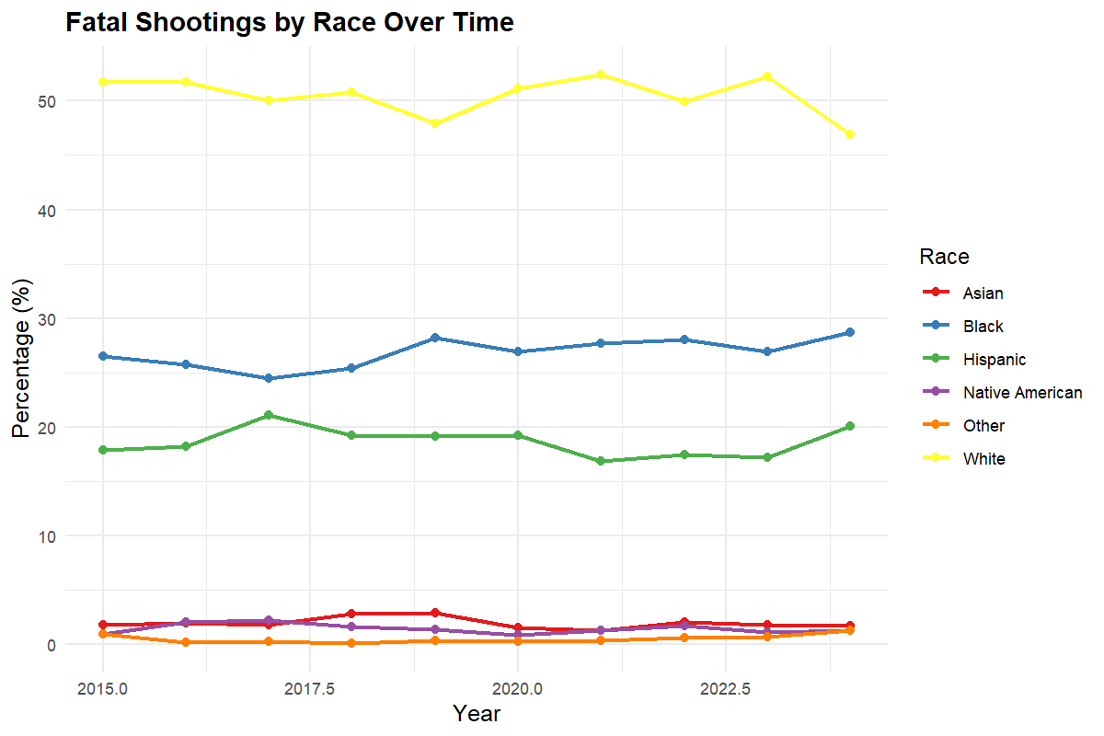
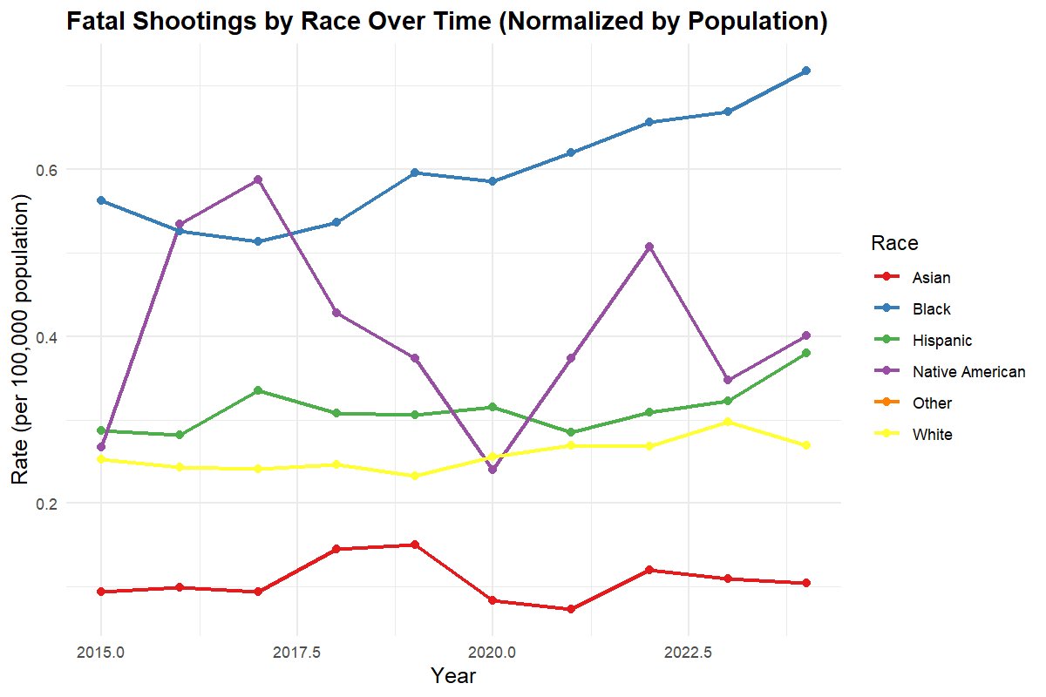
Temporal Trends
Notes:
These graphs show the percentage distribution by race over time on the left and the normalized rates by population on the right. The normalized graph reveals persistent disparities, with Black Americans consistently experiencing higher rates of fatal shootings per capita.

Slide 17
Model Implementation
Hierarchical Clustering:
Goal: Identify patterns among police departments based on shooting frequency, body camera usage, racial composition, and armed status.
Notes:
To analyze patterns among police departments, we chose hierarchical clustering due to its effectiveness in uncovering natural groupings without predefining the number of clusters, allowing us to clearly visualize and interpret departmental differences based on shooting frequency, body camera usage, racial composition, and armed status.

Slide 18
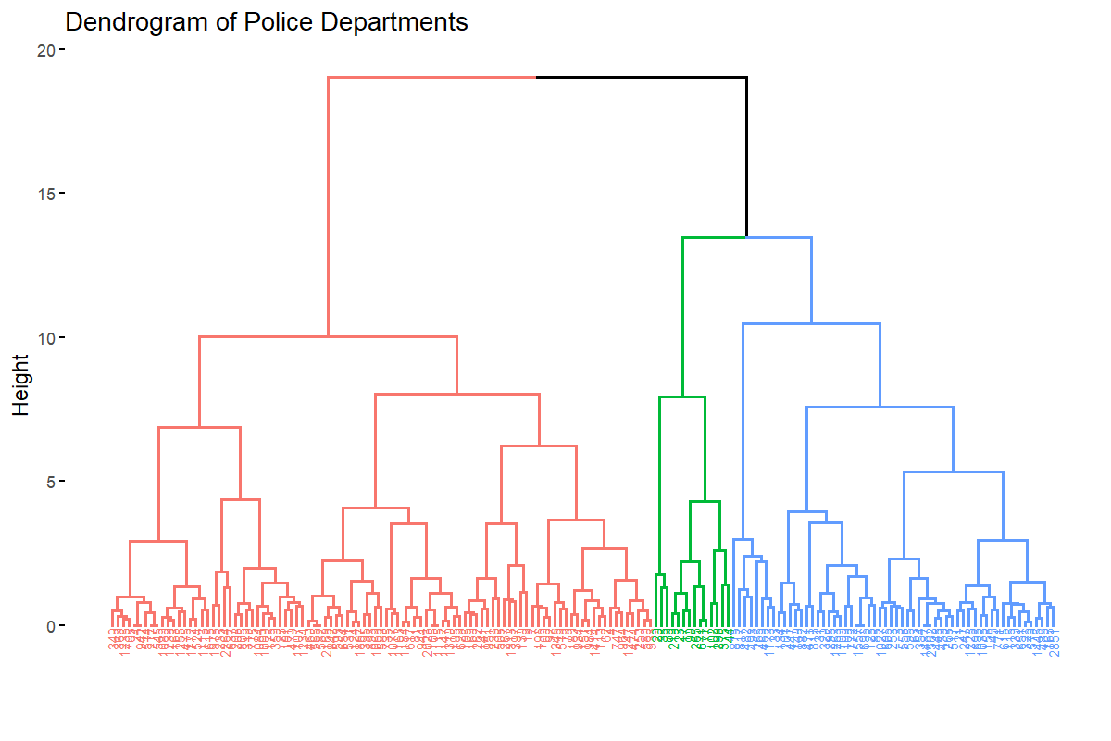
Model Implementation
Dendrogram of Police Departments
Notes:
This dendrogram visualizes our hierarchical clustering results, where each branch represents a police department and the height of connections shows dissimilarity. The three color-coded clusters—red, green, and blue—represent distinct department types with different shooting patterns. The significant vertical distances between these major clusters indicate substantial operational differences, while departments connected at lower heights share similar characteristics.
This tree-like structure helps us identify natural groupings without imposing arbitrary categories

Slide 19
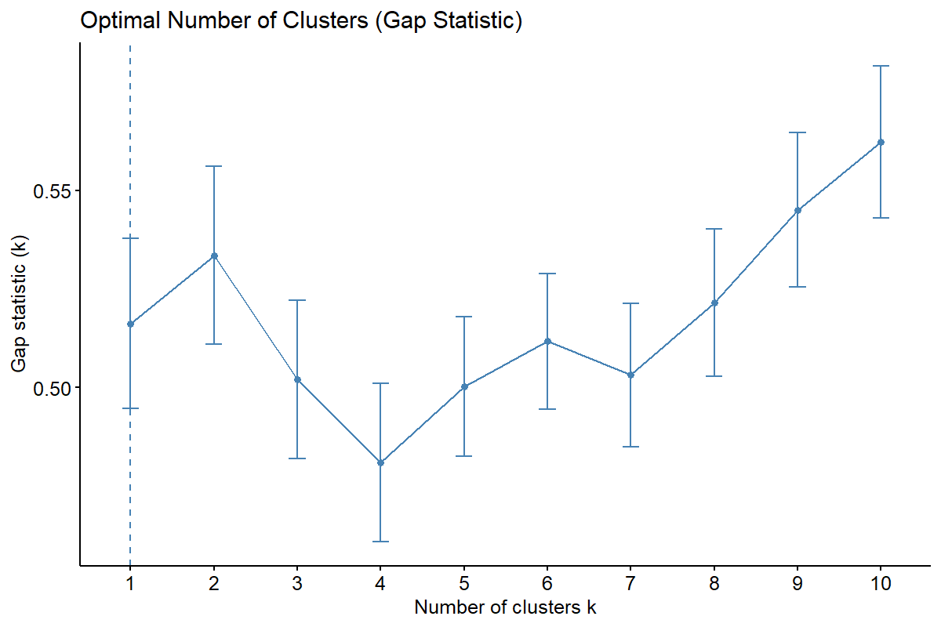
Model Implementation
Optimal Number of Clusters (Gap Statistic)
Notes:
The gap statistic initially suggested 2 clusters as statistically optimal. However, after further exploration with Principal Component Analysis (PCA), we found that 3 clusters better captured the complexity of our data. This 3-cluster structure provided clearer separation among police departments and offered more meaningful insights into their operational differences.

Slide 20
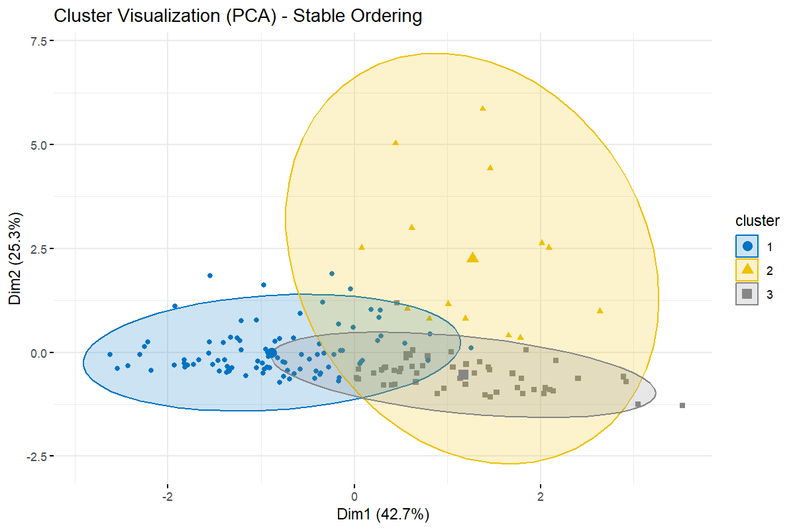
Model Implementation
Cluster Visualization (PCA)
C | Shooting Count (avg) | % Armed Subjects | Race
#1 | Moderate (19.8) | highest (95.7%) | Mostly white victims (52.9%)
#2 | High (73.1) | high (94.5%) | More diverse victims (24.1% white, 45.7% black)
#3 | Lowest (17.1) | lowest (92.0%), | Mostly black victims (56.5%)
Notes:
Our PCA visualization confirms three distinct clusters of police departments, with each dot representing a department positioned based on shooting patterns. The accompanying table summarizes these differences clearly:
Cluster 1 departments have moderate shooting rates with predominantly white victims and the highest armed subject percentage.
Cluster 2 shows metropolitan departments with significantly higher shooting counts and more racial diversity.
Cluster 3 departments have the lowest shooting frequencies but predominantly Black victims, despite having the lowest percentage of armed subjects.
These patterns suggest fundamental differences in department operations, community contexts, and potentially in use-of-force decisions across these groups.

Slide 21
Implications
Department size impact on shooting patterns.
Racial disparities across different department types.
Armed status consistency across all clusters.
Importance of tailored interventions for different department types.
Notes:
Our analysis yields four critical implications:
- First, department size emerges as a key factor in shooting frequency, with larger departments showing distinct patterns.
Second, the racial composition of victims varies dramatically across cluster types, suggesting systemic differences in how departments interact with diverse communities.
Third, despite these differences, the high armed status percentage across all clusters indicates a consistent operational element.
Finally, these distinct profiles demonstrate why reform efforts must be tailored to department types rather than applying universal approaches (one-size-fits-all approaches) that may miss crucial contextual differences

Slide 22
Conclusion
Key Findings:
Differences in police department practices identified through clustering.
Data suggests targeted reforms could reduce fatal incidents.
Broader Impact:
Findings could inform training and accountability measures.
Potential for improving public trust in law enforcement.
Notes:
In conclusion, our clustering analysis has successfully uncovered distinct patterns among police departments regarding fatal shootings.
These insights highlight opportunities for targeted policy reforms and customized interventions, which have the potential to not only reduce fatal incidents but also foster greater transparency, accountability, and public trust in law enforcement

Slide 23

THANKS!

